Slide 1

GeoTweet!
Jeff Brown | Eugenio Gallastegui |
Saira Jahangir | Kamil Borowik | Alan Garbarino

Slide 2
GeoTweet II
GeoTweet I - (project 2)
Backend/Data Management
Demographic Charting
Sentiment Analysis
Machine Learning
Enhancements

Slide 3
GeoTweet I – Project 2
Interactive map with overlay of Twitter trending locations
GeoJSON State boundaries with demographic color scaling based on political affiliation and popups providing US Census statistics
Dynamic table update showing twitter trends by location selected
Responsive scatter plot charts showing demographic data against political affiliation at State level for trending locations
Flask application, SQLite database, Heroku platform
HTML/CSS, Javascript Leaflet, GeoJSON, D3, Plotly, Heroku, SQLite

Slide 4
GeoTweet Enhancements
Enhanced User Experience
New trend dimension – select a trend (from table) to see all trend locations on map
Trend persistence – Up to 3 trends selections built as independent overlays, recycle first overlay when 4th trend selected.
Responsive feedback – D3 chained transition to indicate when a trend is clicked.
HTML/CSS-Javascript-D3

Slide 5

Backend/Data Management
Enhanced to Support Time-Series and Tweet/User-level Analysis
Flask-Postgres-Heroku
Database/Backend Enhancements
Tweets table added: Tweet/User data
Multiple snapshots over time of Trends table entries
Retention over time of Locations and Tweets data
21 Flask Routes
Queries of Locations, Trends, and Tweets tables
Rendering of Main and Demographics pages
Update of Sentiment Analysis, Table Data, Table Status
Support for SQLite and Postgres for development
Deployed on Heroku
Dyno – geotweetapp
Postgres Database – Up to 10M records
Scheduler – Automated updates daily (locations) and hourly (trends and tweets)
Flickr API
Twitter API
Locations
Table
Tweets
Table
Trends
Table

Slide 6
Demographic Charts
Social Context for tweets
Retrieve demographic data from the US census.
Concentrated analysis on employment, education attainment level and political party affiliation (Democratic/Republican) by State.
Modified design to move State overview charts to new Demographics page.
Javascript-Plotly-D3

Slide 7



Sentiment Analysis
This feature takes the user’s input
that triggers the function that works within
the class .
Said function uses ,, , a user-friendly API for Text and Natural Language Processing.

Slide 8


Anatomy of
Takes user’s input to trigger the process
Access the Twitter Data using Twitter API Keys and
Retrieve the hashtags that match the user’s input.
Process the content that accompanies the hashtag using
With the analysis results creates a plot using
Sends the plot from the cloud to the app using an <iframe> embedded into the index.html https://github.com/Euzkaro/Project2.io/blob/master/resources/Sentiment_Analysis.ipynb

Slide 9
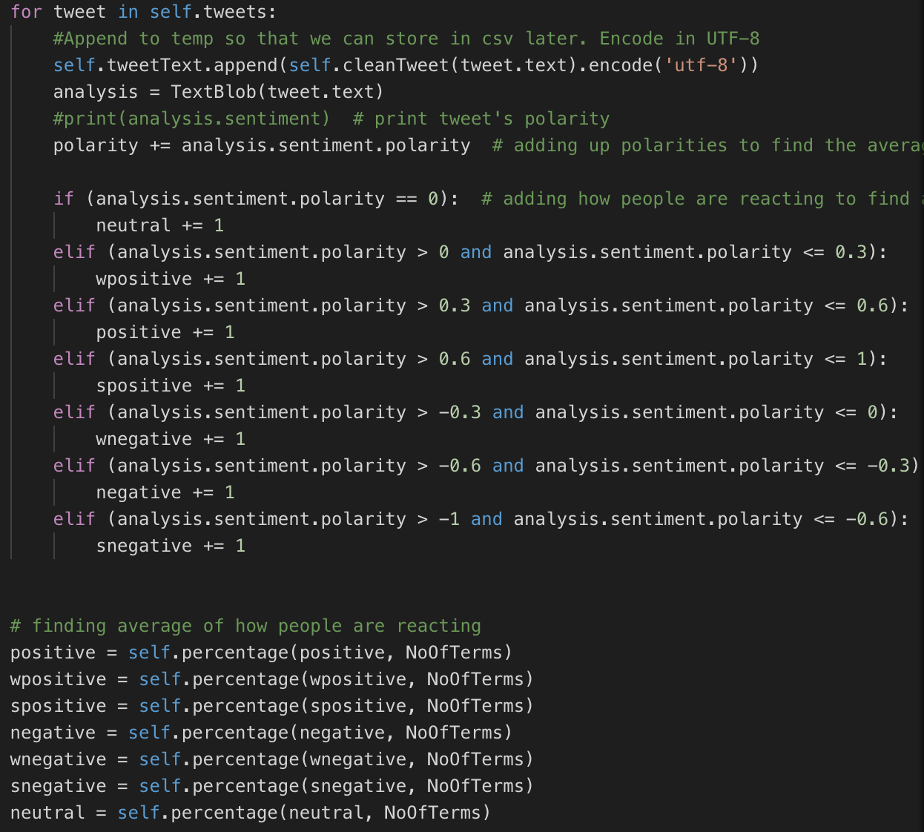
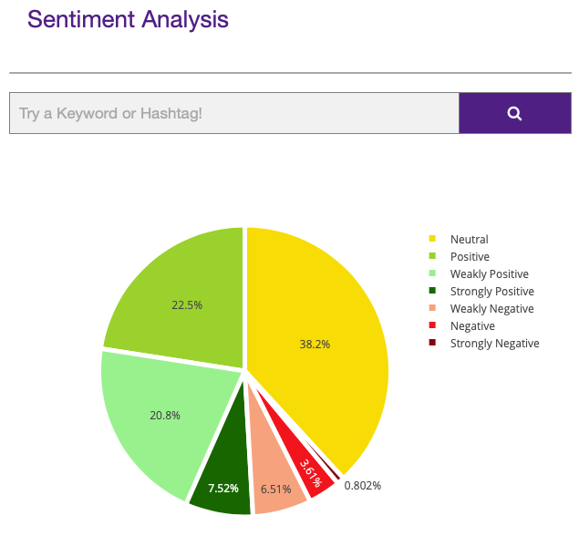
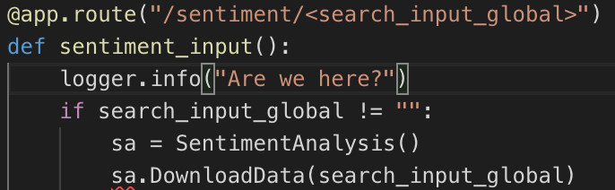
Voilà! Py Flask Plotly / HTML

Slide 10
Machine Learning
Predictive Analytics (Part I)
Predict if a user will be an influencer (> 100 retweets) based on volume in the following user categories
tweet_user_statuses_count: count - user tweets
tweet_user_favourites_count: count - user is a favorite of others tweet_user_followers_count: count - user is followed by others tweet_user_friends_count: count - user friends
tweet_user_listed_count: count - user added to other's interest list
Training Data Score: 0.7653103677816608 Testing Data Score: 0.7660052414825907
Python(Sci-Kit Learn)-Logistic Regression (AIevalSQLite-Scale.ipynb)

Slide 11
Machine Learning
Predictive Analytics (Part II)
Predict using the Scikit-Learn library -> are there any trends in the data sets?
Retrieve tweets by Twitter Categories and perform text pre-processing to convert textual data to numeric data by counting words for each category
Finally, use machine learning algorithms to train and test our model.
Linear Regression Model : lr.score -> 0.676, Random Forest Classifer : lr.score -> 0.75
Python(Sci-Kit Learn, NLK) Linear Regression-Random Forest

Slide 12
Questions

